Slide 1

Spread Footing Design for Columns
Architects and engineers have, to my mind, honorable roles in building things. Life-threatening, property-threatening forces of compression, thrust, and the like need serious countermeasures. - AutoCAD Grandad
Civil Engineering and Architecture
© 2010 Project Lead The Way, Inc.

Slide 2
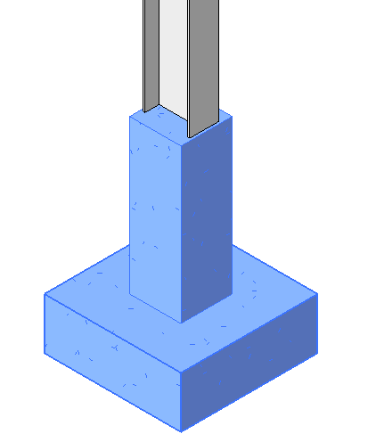
Spread (Column) Footing
The widened part of a foundation that spreads a column load over a broader area of soil
Design based on
  Soil Bearing Capacity
  Column Load
COLUMN
LOAD
PIER (Concrete or Masonry)
SPREAD FOOTING (Concrete)
Notes:
Spread footings are often used to support low rise buildings constructed on soil with relatively high strength near the surface of the ground.
The design of a spread footing depends on the soil strength at the bottom of the footing. This is called the soil bearing capacity.
The design is also dependent on the applied loads that are transferred from the supported column.
Civil Engineering and Architecture
Unit 3 – Lesson 3.2 – Structures
Project Lead The Way, Inc.
Copyright 2010
Spread Footing Design

Slide 3

Column Loads
Roof Loads
Supported Floor Loads
Weight of the Column
Weight of the Foundation
Note: If the ground floor is a slab-on-grade, the loads are not included.
Roof Loads
COLUMN
2nd Floor Loads
1st Floor/ Slab Loads
Soil Bearing Pressure
Notes:
A column will typically carry loads from the roof and elevated floors as well as its own weight.
The footing will carry the column loads as well as the weight of the foundations and transfer these loads to the supporting soil.
Civil Engineering and Architecture
Unit 3 – Lesson 3.2 – Structures
Project Lead The Way, Inc.
Copyright 2010
Spread Footing Design

Slide 4
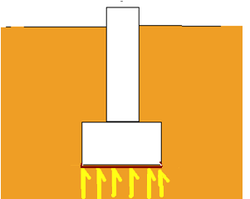
Sizing a Spread Footing
Size based on:
  The total load applied to the soil
  The allowable soil bearing capacity
The pressure applied due to the total load must be less than or equal to the allowable bearing capacity
LOAD
SOIL BEARING PRESSURE
Notes:
Civil Engineering and Architecture
Unit 3 – Lesson 3.2 – Structures
Project Lead The Way, Inc.
Copyright 2010
Spread Footing Design

Slide 5
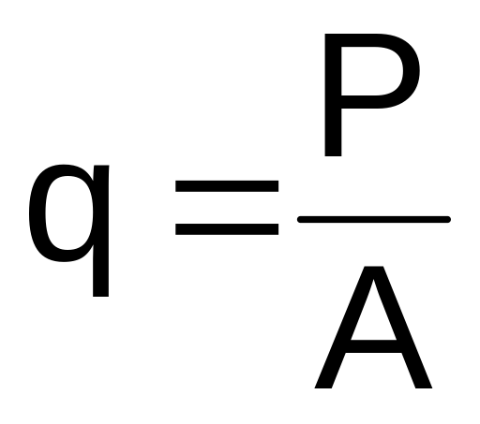
Soil Bearing Pressure
Where q = Soil bearing pressure
P = Load applied
A = Area of the footing
Notes:
Civil Engineering and Architecture
Unit 3 – Lesson 3.2 – Structures
Project Lead The Way, Inc.
Copyright 2010
Spread Footing Design

Slide 6
Soil Bearing Capacities
Soil Type | Allowable Soil Bearing (lb/ft ²) | Drainage
BEDROCK | 4,000 to 12,000 | Poor
GRAVELS | 3,000 | Good
GRAVELS w/ FINES | 3,000 | Good
SAND | 2,000 | Good
SAND W/ FINES | 2,000 | Good
SILT | 1,500 | Medium
CLAYS | 1,500 | Medium
ORGANICS | 0 to 400 | Poor
Notes:
The allowable soil bearing capacities are noted for different types of soils. These are commonly used values and may be referred to as the presumptive soil bearing capacity. Also noted on the chart are the drainage characteristics of the soil types.
Civil Engineering and Architecture
Unit 3 – Lesson 3.2 – Structures
Project Lead The Way, Inc.
Copyright 2010
Spread Footing Design

Slide 7

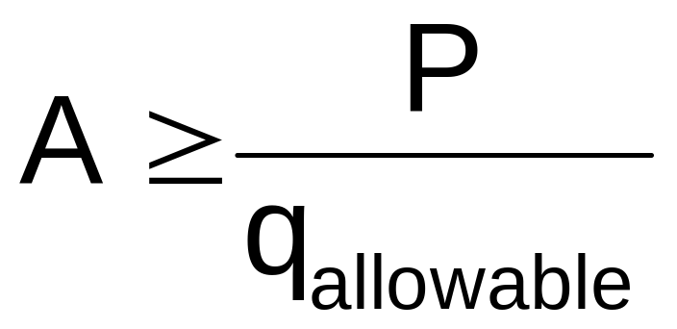
Required Footing Area
q_{allowable} ≥ q
Where q_{allowable} = Allowable soil bearing pressure
Notes:
In order for the soil to safely support the loads, the allowable soil bearing pressure must be greater than or equal to the soil bearing pressure.
[click] Therefore, since q = P/A, the allowable soil bearing pressure must be greater than or equal to P/A.
[click] Since I know that both A and q_{allow} will be positive, I can manipulate the inequality to show that the spread footing area must be greater than the load divided by the allowable soil bearing capacity.
We only have one slight problem with using this formula. In order to find the total load, P, we need to include the weight of the foundation. But we won’t know the weight of the foundation until we find the required area. We have a dilemma.
One way to approach this problem is to approximate a footing size in order to estimate the footing weight and then calculate the required area. Then we would need to compare our approximation to the calculated size. If the approximation was not sufficiently close to the calculated size, we may need to perform the calculation again.
But there is an easier way to find the area without reiterating the calculation.
Civil Engineering and Architecture
Unit 3 – Lesson 3.2 – Structures
Project Lead The Way, Inc.
Copyright 2010
Spread Footing Design

Slide 8
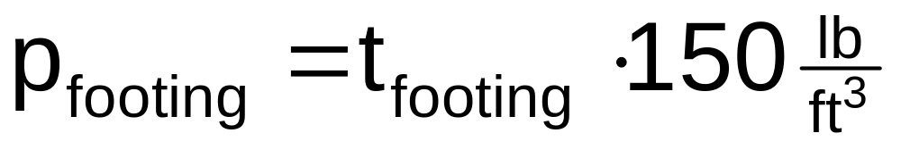
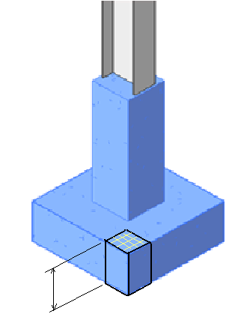

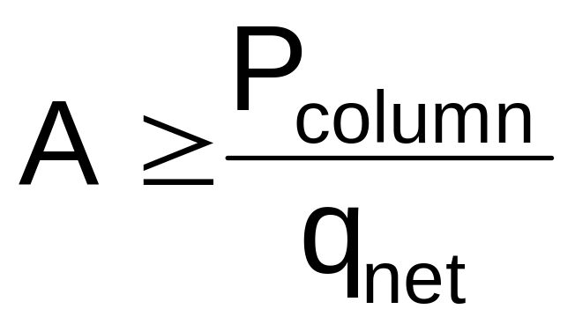
Net Allowable Bearing Pressure
1 ft²
t _{footing}
Notes:
In most cases, because changing the size of a spread footing changes the weight of the footing itself, sizing a spread footing is easier if we can remove the weight of the footing from the calculation.
If we know the thickness of the footing, which is fairly standard on a project, we can figure out how much pressure a square foot area of the footing will apply to the soil, called p_{footing}.
[click] We can calculate the soil pressure that results from the footing weight by multiplying the footing thickness by the density of concrete. Standard weight concrete has a density of 150 lb/ ft³.
[click] We can then subtract this footing pressure from the allowable soil bearing pressure to obtain a net allowable soil bearing pressure. The net pressure is the allowable pressure that remains to support the column design load after the weight of the footing is accounted for.
[click] Therefore, the area of the footing can be calculated by dividing the load applied from the column (without including the footing weight) by the net allowable soil pressure.
Civil Engineering and Architecture
Unit 3 – Lesson 3.2 – Structures
Project Lead The Way, Inc.
Copyright 2010
Spread Footing Design

Slide 9
Required Footing Area
Using Net Allowable Soil Bearing Pressure
Notes:
This is the best equation to use to size a spread footing if you know the footing thickness. With this equation, you do not need to know the weight of the footing before you actually size it.
Civil Engineering and Architecture
Unit 3 – Lesson 3.2 – Structures
Project Lead The Way, Inc.
Copyright 2010
Spread Footing Design

Slide 10
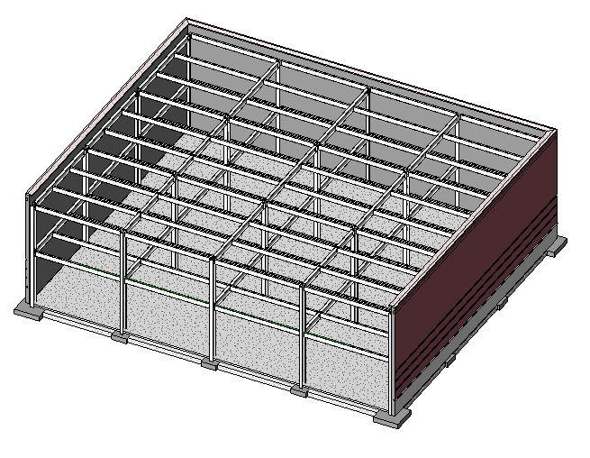
Example
Size a spread footing for Column B-3 in the building shown below. The footing thickness is 1ft 9in. Assume that the footings bear on silty sand with an allowable soil bearing pressure of 3000 psf.
COLUMN B-3
3D View of Retail Building
Steel framing and 1st floor slab shown
Notes:
We will size a spread footing for column B-3.
Civil Engineering and Architecture
Unit 3 – Lesson 3.2 – Structures
Project Lead The Way, Inc.
Copyright 2010
Spread Footing Design

Slide 11
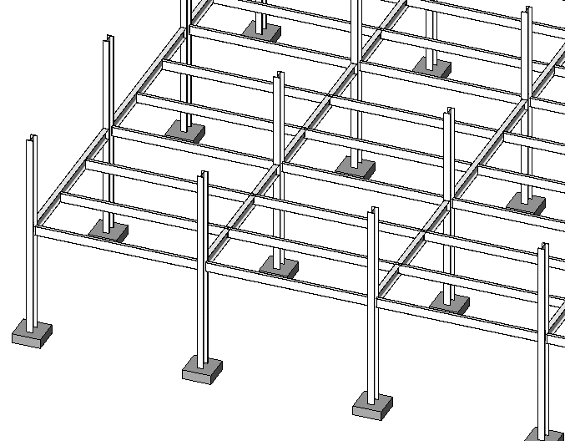
Example
Partial 2nd Floor Framing 3D View
Girder
Beam
Column
Footing
Notes:
The load from the roof and second floor framing will be transferred through the columns to the spread footings.
Civil Engineering and Architecture
Unit 3 – Lesson 3.2 – Structures
Project Lead The Way, Inc.
Copyright 2010
Spread Footing Design

Slide 12
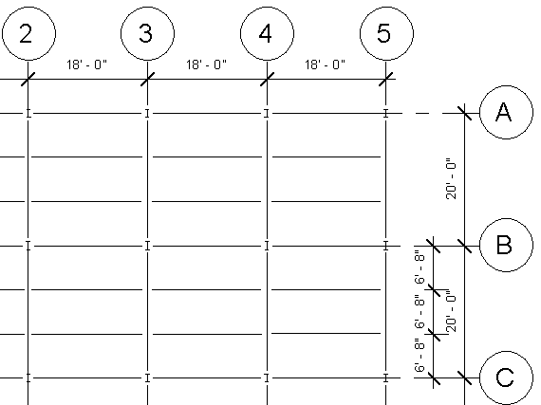
Example
Partial 2nd Floor Framing
Girder
Beam
Beam
Girder
Column B-3
Notes:
Column B-3 supports two girders and two beams on the 2nd Floor. It also supports two beams and two girders on the roof.
Civil Engineering and Architecture
Unit 3 – Lesson 3.2 – Structures
Project Lead The Way, Inc.
Copyright 2010
Spread Footing Design

Slide 13
Column Loads
Assume that an engineer has performed analyses for the floor and roof members with the following results:
Roof Beam Reaction = 5,000 lb
Roof Girder Reaction = 10,000 lb
2nd Floor Beam Reaction = 13, 500 lb
2nd Floor Girder Reaction = 27,000 lb
Notes:
Civil Engineering and Architecture
Unit 3 – Lesson 3.2 – Structures
Project Lead The Way, Inc.
Copyright 2010
Spread Footing Design

Slide 14
Column Loads
Roof
Interior Beam End Reaction x 2
= (5,000 lb) 2 = 10,000 lb
Interior Girder End Reaction x 2
= (10,000 lb) 2 = 20,000 lb
2nd Floor
Interior Beam End Reaction x 2
= (13,500 lb) 2 = 27,000 lb
Interior Girder End Reaction x 2
= (27,000 lb) 2 = 54,000 lb
Column Weight = 1,500 lb
TOTAL COLUMN LOAD = 112,500 lb
Roof
2nd Floor
1st Floor Slab
Notes:
A column will typically carry loads from the roof and elevated floors as well as its own weight.
The footing will carry the column loads as well as the weight of the foundations and transfer these loads to the supporting soil.
In this case, the roof loads include 10,000 lb from two interior beams that frame into the column. [click]
20,000 lb from the two girders that frame into the column [click[
The 2nd Floor loads include 27,000 lbs from the two floor beams [click] and 54,000 lb from the two floor girders [click].
In addition, the column itself weights 1,500 lbs. [click]
That sums to a total column load of 112,500 lbs. [click]
The building loads will create a pressure on the supporting soil equal to the total force applied divided by the area of the footing.
Civil Engineering and Architecture
Unit 3 – Lesson 3.2 – Structures
Project Lead The Way, Inc.
Copyright 2010
Spread Footing Design

Slide 15



Calculate the Net Allowable Soil Bearing Pressure
Notes:
To calculate the net allowable soil bearing pressure, [click] first find the pressure caused by the weight of the 1ft 9in. (1.75ft) thick footing.
[click] Then subtract the footing pressure from the allowable soil bearing pressure of 3000 psf.
Civil Engineering and Architecture
Unit 3 – Lesson 3.2 – Structures
Project Lead The Way, Inc.
Copyright 2010
Spread Footing Design

Slide 16



Required Footing Area
Notes:
[click] Next, find the required footing area using the calculated column load and q net.
[click] The footing area must be greater than 41.1 square feet.
Civil Engineering and Architecture
Unit 3 – Lesson 3.2 – Structures
Project Lead The Way, Inc.
Copyright 2010
Spread Footing Design

Slide 17



Footing Shape
Notes:
Once you know the required footing area, you must decide on the shape of your footing. Many spread footings are square unless a specific reason exists to use another shape. For instance a spread footing may support two footings and may require a rectangular shape in order to fall under both footings. An interference with underground equipment may not allow for the use of a square footing.
In some cases, when the area is small, circular tube forms may be used to reduce construction costs.
Civil Engineering and Architecture
Unit 3 – Lesson 3.2 – Structures
Project Lead The Way, Inc.
Copyright 2010
Spread Footing Design

Slide 18


Square Footing Size
6’ -6”
6’ -6”
Use 6'- 6'' x 6'- 6'' x 1'- 9'' thick
Notes:
6.4 feet is equivalent to 6ft 4.8in. Always round UP when designing footings – if you round down, the design soil bearing pressure will exceed the allowable soil bearing pressure. Designers will typically round up to the next 2 or 3in. increment. Round to the next 3in. increment in this instance. Say 6ft 6in.
Civil Engineering and Architecture
Unit 3 – Lesson 3.2 – Structures
Project Lead The Way, Inc.
Copyright 2010
Spread Footing Design

Slide 19




Round Footing Size
7'-6''
Say 3ft 9in. radius
Use 7'- 6'' diameter x 1'- 9'' thick
Notes:
A 3ft 9in. radius means a 7ft 6in. diameter since diameter = 2 x radius.
Civil Engineering and Architecture
Unit 3 – Lesson 3.2 – Structures
Project Lead The Way, Inc.
Copyright 2010
Spread Footing Design

